Slide 1
Case Study Audible Data Cleaning Project
Presented by
Sayooj R

Slide 2
Problem Statement
01
You are working at Audible.
Utilize Power Query Editor in excel to clean and standardize an Audible dataset.
Tasks include formatting column, ensuring data consistency, and preparing the dataset for analysis.

Slide 3
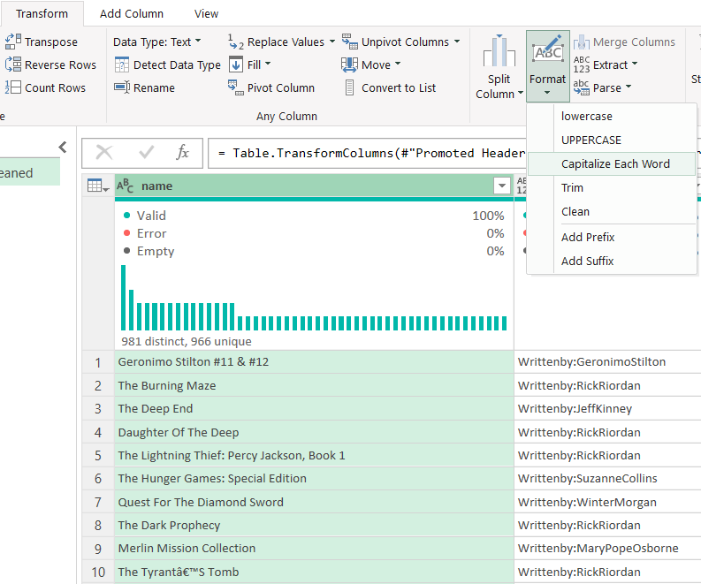
Standardize the name column to ensure consistent title casing.
STEP :
Transform -> Text column ->
Format -> “ Capitalize Each Word “

Slide 4
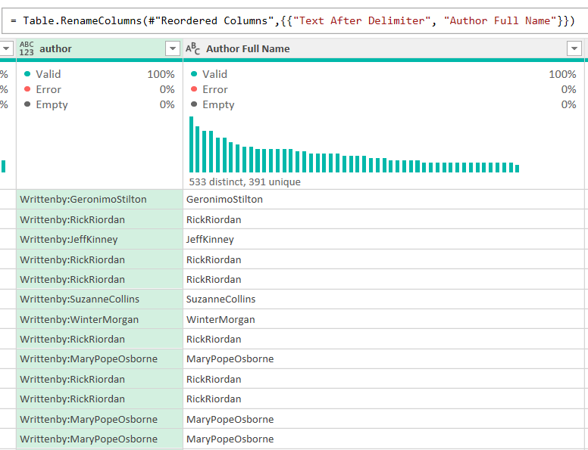

2. Separate combined first and last names in the author column if they are currently combined.
Current Output
STEP 1 :
Add Column -> From Text ->
Format -> “ Text After Delimiter “
Applied Steps

Slide 5
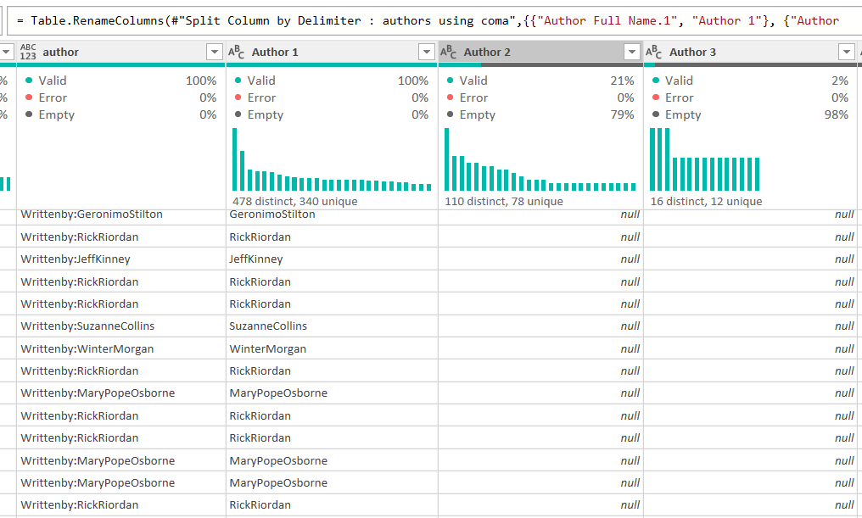

STEP 2 :
Transform -> Text Column ->
Split Column -> “ By Delimiter “
Current Output
Applied Steps

Slide 6
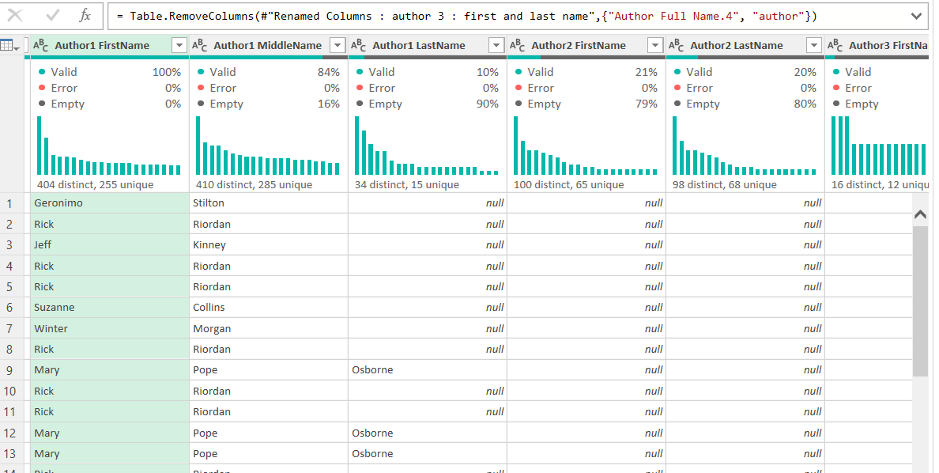
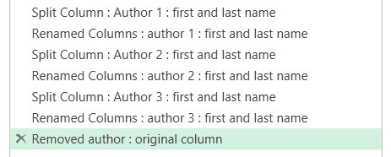
Final Output
Applied Steps
STEP 3 :
- Transform -> Text Column ->
Split Column -> “ By Lowercase to Uppercase “
- Repeat the same step for Author 2, 3 also.
- At the end delete the original author column.

Slide 7
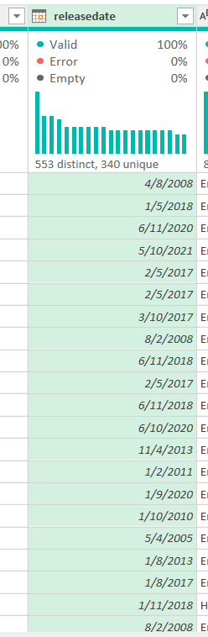

3. Ensure all entries in the releasedate column follow a consistent date format (DD-MM-YYYY).
Current
Output :
STEP :
- Changed data type from text -> date.
- Remove errors from the column.
Applied Steps

Slide 8
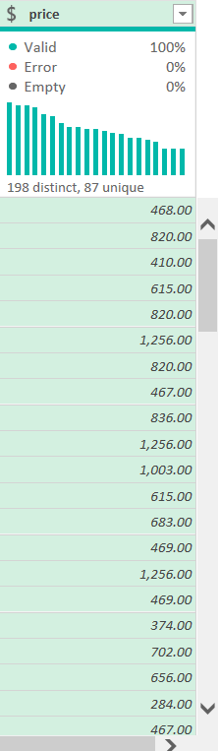

4. Ensure the price column is in a numeric format, and identify any non-numaeric values.
Output :
STEP :
- Changed data type from text -> currency.
- Remove errors from the column.
Applied Steps

Slide 9
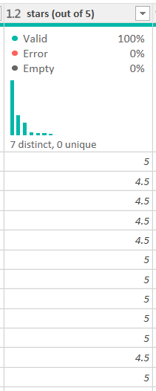
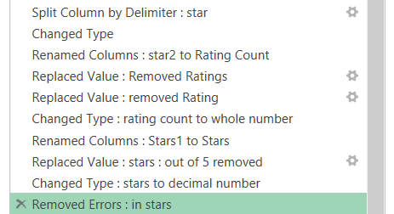
5. Convert text ratings in the stars column to numeric values.
Output :
STEP :
- Split Column using required delimiter.
- Replace unwanted strings with blank.
- Change data type to decimal number.
Applied Steps

Slide 10
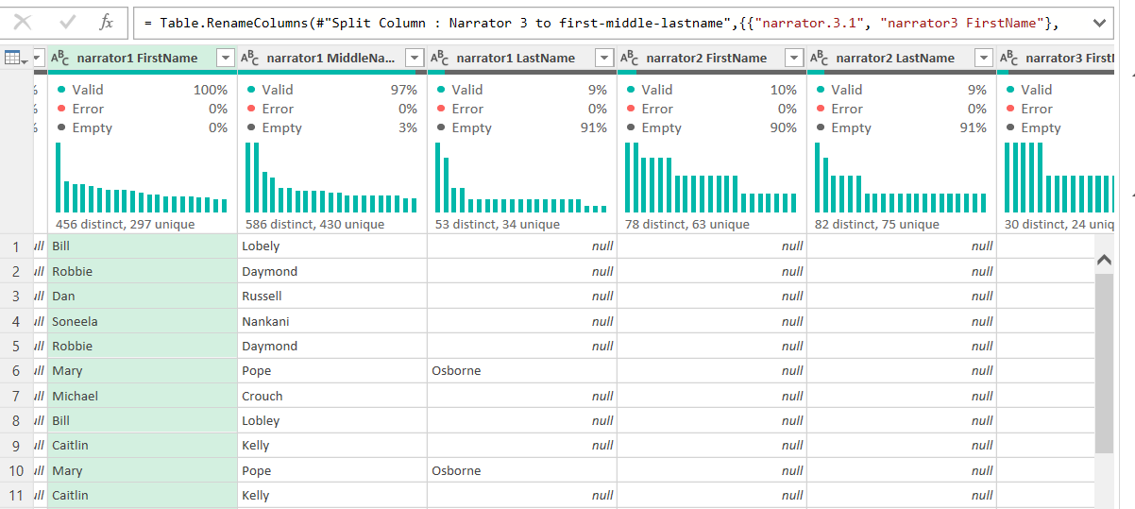
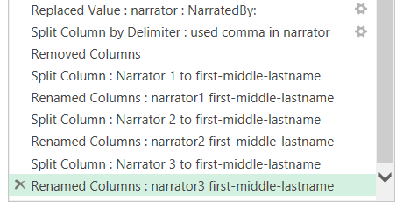
6. Split the narratedby column into multiple columns if multiple narrators are listed.
Output :
Applied Steps
STEP :
- Transform -> Replace value -> remove NarratedBy:
- Transform -> Split Column -> By Delimiter
- Transform -> Text Column -> Split Column -> By lowercase to uppercase to get first & last name

Slide 11
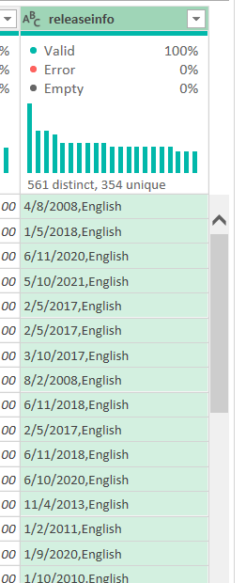
7. Merge the releasedate and language columns into a single new column named releaseinfo with the format "DD-MM-YYYY, Language."
STEP :
Output :
- Add Column -> From Text -> Merge Columns
Applied Steps

Slide 12
8. Ensure all currency values in the price column are formatted consistently with two decimal places.
Output :
STEP :
- Changed data type from text -> currency.
- Remove errors from the column.
Applied Steps

Slide 13
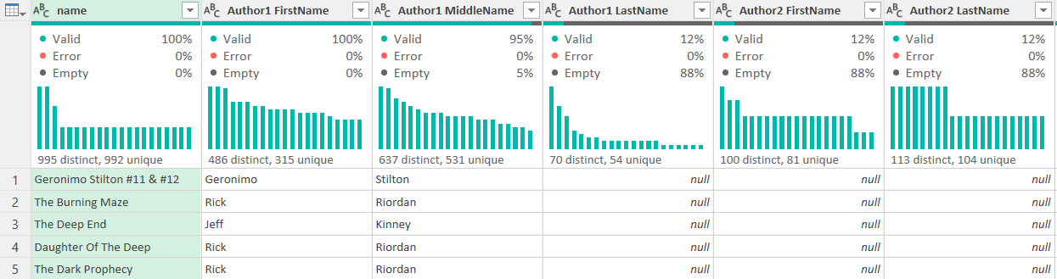
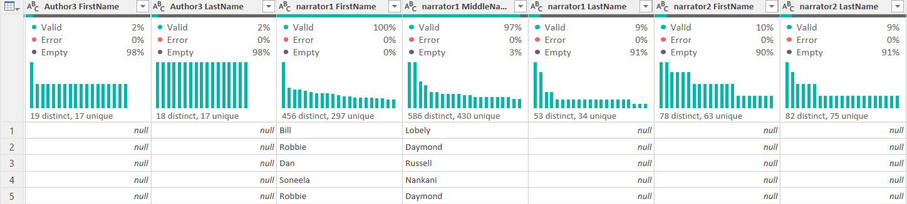
FINAL OUTPUT

Slide 14
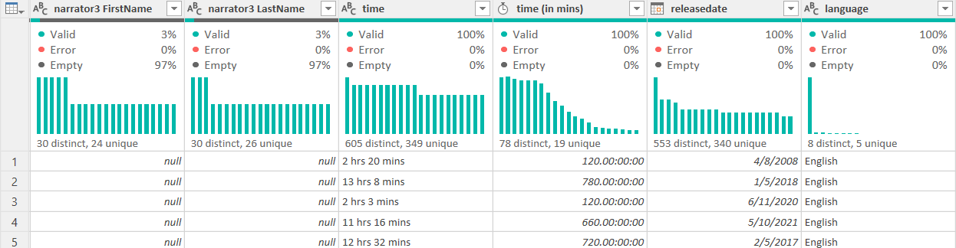
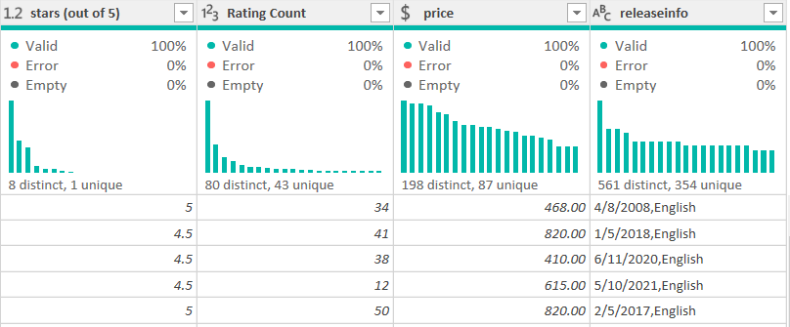

Slide 15
THANK YOU

